Slide 1
Model Context Protocol Introduction
Dr M Janaki Meena
Professor, SCOPE
VIT Chennai

Slide 2
Agents
An agent is anything that can perceive its environment and act upon that environment
Agent - Characterized by environment it operates in and set of actions it can perform.
Game playing agent - game is its environment
Web Scraping – Internet
Self-driving car – Road system and adjacent areas
ChatGPT - Search the web, execute Python code, and generate images.
Set of actions - augmented by the tools it has access to

Slide 3
Empowering LLMs: A Step Toward Agentic AI
Large language models (LLMs) work in isolation — they can only use the text context you give them
LLMs predict the probability of the next word
With tool calling, you can extend the model’s abilities by attaching external data sources or tools dynamically at runtime.

Slide 4
Tool calling
A mechanism that allows a Large Language Model (LLM) to call external functions, APIs, or tools by producing structured output (like JSON).
Instead of responding only with text, the model can decide:
“I need to use this tool to get the answer.”

Slide 5
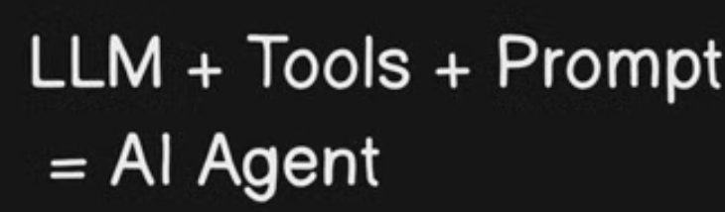
Agents

Slide 6
Drawbacks and Limitations of Tool Calling
No Standardization
Each LLM vendor (OpenAI, Anthropic, Google, Mistral, etc.) has its own way of defining tools.
JSON schema formats differ slightly.
You can’t reuse the same tool definitions across models.
Led to portability issues. A tool built for GPT-4 won’t work as-is with Claude or Gemini.

Slide 7
Drawbacks and Limitations of Tool Calling
Manual Integration
Developers must hardcode every tool and define how it connects to external systems.
There’s no auto-discovery or dynamic registration of tools.
Scaling from 3 to 30 tools quickly becomes a maintenance burden.
Led to fragile orchestration and poor scalability

Slide 8
Drawbacks and Limitations of Tool Calling
Opaque and Risky Data Access
Once you connect APIs, you must trust the LLM to call them correctly.
There’s no visibility or inspection mechanism for end-users.
It’s easy to leak sensitive data if not sandboxed carefully.
Privacy and security risks

Slide 9
Drawbacks and Limitations of Tool Calling
Limited Context Sharing
Tool outputs must be fed back into the prompt manually.
No standard for maintaining shared context (memory, history, or knowledge graph).
Each developer builds their own way to “chain” results.
Redundant data handling, increased token costs

Slide 10
Drawbacks and Limitations of Tool Calling
No Multi-Tool Reasoning Standard
Models can technically call multiple tools, but coordinating multi-step reasoning (e.g., "plan → search → compute → summarize") requires external orchestration (LangChain, Semantic Kernel, etc.)
LLM doesn’t natively understand dependencies between tools
Developers must build agent frameworks on top of tool calling

Slide 11
Drawbacks and Limitations of Tool Calling
Hard to Audit or Explain
There’s no transparent way to see:
What tools were available
What the model actually called
What data was passed
Tool calling logs are usually hidden or partial
Poor explainability and traceability — a problem for regulated domains (finance, healthcare, education).

Slide 12
So how do we solve all these problems at once?

Slide 13
Model Context Protocol (MCP)
Open standard introduced by Anthropic in November 2024
Defines a structured way for AI models (like Claude or others) to connect with external tools, APIs, databases, or other context sources
Connect in a secured, standardized, and inspectable way
MCP is like the "API protocol" that lets AI agents talk to the outside world

Slide 14
Model Context Protocol (MCP)
Provide reference MCP servers/implementations for common systems (Google Drive, Slack, GitHub, Git, Postgres, Puppeteer) that developers can adopt.
Already finding traction across multiple domains and industries because it solves a universal problem
Securely connecting LLMs to real-world tools, workflows, and private data.

Slide 15
Solution by MCP for No Standardization
Open, vendor-neutral specification published by Anthropic.
Tools, data sources, and context connections are defined using a consistent JSON-RPC interface.
Any compliant client (Claude, Ollama, local agent) can connect to any compliant MCP server.
Instead of every car company making its own kind of plug, MCP defines the “universal charging port” for all models.

Slide 16
Solution by MCP for Manual Integration
Dynamic tool discovery
When an MCP client connects to an MCP server, the server announces the list of tools and data sources it provides.
Model can query list_tools or list_resources to know what’s available.
New tools can be added to a server without modifying the client.
Instead of hardcoding all APIs, the LLM “browses” a catalog of available tools at runtime.

Slide 17
Solution by MCP for Opaque and Risky Data Access
User-inspectable connections
MCP clients (like Claude Desktop or MCP Inspector) show exactly:
Which servers are connected
What tools and data sources they expose
What actions the model can perform

Slide 18
Solution by MCP for Opaque and Risky Data Access
Explicit consent: Model can’t access a resource unless the user explicitly authorizes that server.
Sandboxed execution: Each MCP server runs in a separate process — so compromising one doesn’t expose others.
Like Android’s app permissions — you can see and control what each “app” (server) is allowed to do.

Slide 19
Solution by MCP for Limited Context Sharing
MCP introduces “Resources” and “Prompts”
Resources = structured, queryable data (like files, databases, APIs)
Prompts = reusable contextual templates (like named prompt snippets)
Model can dynamically fetch and reuse these without embedding large text chunks every time.

Slide 20
Solution by MCP for Limited Context Sharing
Context persistence is handled by the protocol, not by manual prompt engineering.
Instead of stuffing data into every conversation, the LLM can “mount” a shared drive of data sources and refer to them when needed.

Slide 21
Solution by MCP for No Multi-Tool Reasoning Standard
MCP defines a consistent interface for all tools
Client (model or agent layer) can orchestrate multi-step tool use automatically.
The LLM can plan → call → observe → act → iterate, all within the same session.
Since tool metadata is standardized, orchestration frameworks can be built once and reused.🧠

Slide 22
Solution by MCP for No Multi-Tool Reasoning Standard
Instead of teaching every model how to use every machine, MCP makes all machines follow the same instruction manual — easier to automate workflows.

Slide 23
Solution by MCP for Hard to Audit or Explain
Full introspection
Tools and data sources are enumerable — the client or user can inspect their definitions.
Inspectors and Logs: Tools like mcp-inspector can visualize all tool calls, inputs, and outputs.
Reproducibility: Since MCP uses JSON-RPC, every request/response is logged and replayable.

Slide 24
Solution by MCP for Hard to Audit or Explain
MCP is like adding a flight recorder (“black box”) to every AI action — every tool call is traceable and inspectable.

Slide 25
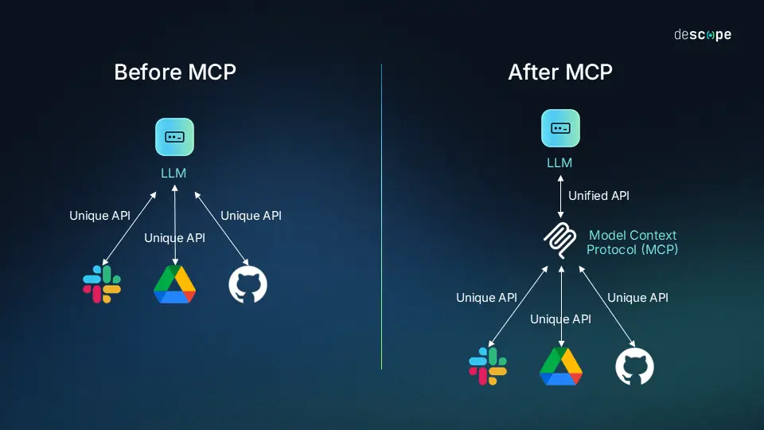

Slide 26
Fields Where MCP Is Being Used (or Explored)
Field / Sector | How MCP Is Used | Example Use Cases
Healthcare | Securely connecting AI models to medical databases and diagnostic tools | - Let clinicians query anonymized patient data via an MCP-SQL server - Access medical literature through an MCP-PubMed connector - Use MCP-Python for model-assisted data analysis

Slide 27
Fields Where MCP Is Being Used (or Explored)
Field / Sector | How MCP Is Used | Example Use Cases
Education & EdTech | Bridging LLMs with Learning Management Systems (LMS) and institutional repositories | - Personalized tutoring agents that fetch materials via MCP - Automated grading or analytics from student performance databases - Research assistants that access academic sources securely

Slide 28
Fields Where MCP Is Being Used (or Explored)
Field / Sector | How MCP Is Used | Example Use Cases
Enterprise / Business Automation | Integrating LLMs with internal systems (ERP, CRM, HRMS, etc.) | - MCP servers connect Claude or other models to internal APIs - Generate reports, answer queries, or automate workflows safely - No sensitive data leaves the org boundary

Slide 29
Fields Where MCP Is Being Used (or Explored)
Field / Sector | How MCP Is Used | Example Use Cases
Software Development | AI coding assistants with access to local codebases and build systems | - MCP-Git or MCP-Filesystem servers let models browse, refactor, or explain code - Continuous integration analysis via MCP pipelines

Slide 30
Fields Where MCP Is Being Used (or Explored)
Field / Sector | How MCP Is Used | Example Use Cases
Finance & Banking | Secure analysis of sensitive financial datasets | - Connect to on-premise SQL servers for auditing or anomaly detection - MCP ensures auditable model interactions — critical for compliance

Slide 31
Fields Where MCP Is Being Used (or Explored)
Field / Sector | How MCP Is Used | Example Use Cases
Legal & Compliance | Controlled document analysis and retrieval | - MCP servers manage access to legal repositories or case databases - Enables contract review or case summarization under strict governance

Slide 32
Fields Where MCP Is Being Used (or Explored)
Field / Sector | How MCP Is Used | Example Use Cases
Media & Publishing | Automated content creation with structured source access | - MCP connectors to content management systems - Maintain editorial control and traceable content sourcing

Slide 33
Fields Where MCP Is Being Used (or Explored)
Field / Sector | How MCP Is Used | Example Use Cases
Retail & E-commerce | AI-powered operations and analytics | - MCP links to inventory or customer data systems - Enables sales forecasting or personalized marketing while respecting privacy

Slide 34
Fields Where MCP Is Being Used (or Explored)
Field / Sector | How MCP Is Used | Example Use Cases
Scientific Research | Reproducible AI experiments and data linking | - Use MCP to connect LLMs to experimental datasets, simulation tools, or papers - Ensure reproducibility by keeping all data interactions logged

Slide 35
Fields Where MCP Is Being Used (or Explored)
Field / Sector | How MCP Is Used | Example Use Cases
Government & Defense (Exploratory) | Secure, auditable agent interactions | - MCP provides transparency, vital for compliance-heavy public sectors

Slide 36
Why Students & Academicians Should Learn MCP
Future-Proof Your Research & Career
The AI Landscape is Fragmenting
Today: Claude, GPT-4, LLaMA, Gemini, Mistral, etc.
Tomorrow: Hundreds more specialized models
Problem: Each has different APIs, formats, quirks

Slide 37
Why Students & Academicians Should Learn MCP
MCP = Universal Standard
Like how USB-C replaced dozens of charging cables
Write tool integration code once, use with any model
Your research code won't become obsolete when new models emerge

Slide 38
Why Students & Academicians Should Learn MCP
Career Relevance
Traditional Approach: Learn Claude API → GPT API → LLaMA API → ...
MCP Approach: Learn MCP once → Work with ALL models

Slide 39
Why Students & Academicians Should Learn MCP
Accelerate Academic Research
Scenario 1: Comparative Studies
Research Question: "Which LLM is best for analyzing medical literature?"

Slide 40
Why Students & Academicians Should Learn MCP
Without MCP:
Write data extraction tools for Claude ⏱️ 2 weeks
Rewrite for GPT-4 ⏱️ 2 weeks
Rewrite for LLaMA ⏱️ 2 weeks
Total: 6 weeks before actual research starts!

Slide 41
Why Students & Academicians Should Learn MCP
With MCP:
With MCP:
Write MCP server once ⏱️ 2 weeks
Test all 3 models ⏱️ 1 day
Total: 2 weeks, start research immediately

Slide 42
Academic Use Cases - For Students
Use Case | Tools
Literature Review Automation | search_arxiv extract_methodology, compare_results, generate_summary_table
Data Analysis Assistant | run_regression, check_assumptions, visualize_distribution, suggest_tests
Coding Assignment Helper | explain_error suggest_optimization check_complexity

Slide 43
Academic Use Cases - For Professors
Use Case | Tools
Automated Grading Assistant | check_code_correctness, evaluate_essay_structure, detect_plagiarism_patterns, provide_feedback
Research Data Pipeline | clean_experimental_data, run_statistical_tests, generate_plots, export_latex_table
Grant Writing Assistant | check_compliance, suggest_relevant_citations, estimate_budget_justification, format_to_template

Slide 44
RoadMap for 27th October 2025
Discussion on MCP Architecture
Connecting with existing MCP Servers with Claude Desktop
Connecting with local DB using MCP Server with Claude Desktop
Building toy MCP Server and Clients
Building a MCP Server for image rotation using OpenCV
Build a Flask and FastAPI apps to test the Server built

Slide 45
Thank You
Meet you Tomorrow :)

